Slide 1
Rectilinear Steiner Minimum Tree Construction
CS6100: Course Project

Slide 2
Team Members
CS18B049 - Abhishek Santhanam
CS18B052 - Arihant Samar
CS17B104 - Kshitij Bipin Deogade
CS17B105 - Prashanth T

Slide 3
Introduction
RECTILINEAR STEINER TREE
Finding the minimum spanning tree which must contain a set of points called Terminals
Can contain some extra points called the Steiner Points.
Distance metric used is the Manhattan metric.This is particularly useful in physical design of electronic design automation.For example, in VLSI circuits, wire routing is carried out by wires running only in vertical and horizontal directions

Slide 4
Algorithm
The function Const_optRST takes a Graph and returns the optimal Rectilinear Steiner tree (for at most 7 points) using the functions extreme and fork.
The function extreme grows a Graph G by adding edges to it until there is no unique point which has the minimum/maximum x or y coordinate, or G contains just a single point (G is “grown” in this case).

Slide 5
Algorithm
The edges are added from an “extreme” (minimum/maximum x/y-coordinate) point to the second most “extreme” point on the same axis.
After extreme has completed its task, the function fork generates 3 different trees for an “extreme” pair of coaxial points (having the same maximum/minimum x/y-coordinate) by adding and removing edges from the existing graph.These trees are added to the TreeList to be processed later by Const_optRST.
Once the TreeList has been completely processed, Const_optRST returns the tree with the least L value.

Slide 6
Algorithm Implementation
In the function main we divide the set of input terminals sequentially by x-coordinate into smaller “districts” which has at most 7 terminals ; and the optimal RST is computed for each of them using Const_optRST function.
Since each district has a common vertex with the following district, the computed RSTs are directly connected, eliminating the need for additional edges.
The combined tree’s cost is reduced with the help of optimise function as explained on the next slide.

Slide 7
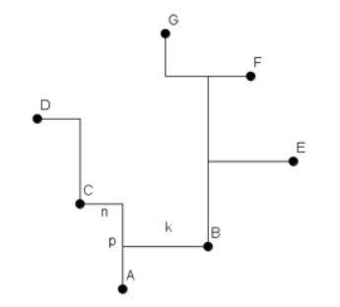
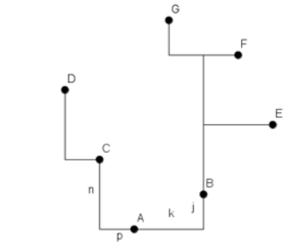
Optimisation of Tree Length
When the common point between trees of 2 districts is higher or lower than both its adjacent vertices, we can optimise the tree to reduce its length.

Slide 8
IMPROVEMENTS
The minimum/maximum coordinate point is directly moved to the second minimum/maximum coordinate to speeden the EXTREME function
A similar optimization was done for the FORK function
`
v
v
u
uo
un
x
x
w
z
z
y
y

Slide 9
IMPROVEMENTS
The minimum/maximum coordinate point is directly moved to the second minimum/maximum coordinate to speeden the EXTREME function
A similar optimization was done for the FORK function
`
v
v
u
uo
un
x
xo
xn
z
z
y
yo
yn

Slide 10
Improvements to the Algorithm
Combine function helps to increase the cases for optimise function to reduce the cost.
u
Without combine, optimise function will check if u has any neighbours which are vertically above or below.Since there are none, it will be skipped. With combine , the edges are combined and it can be optimised.

Slide 11
Method used for evaluation
n=[100,600,...,5600] ; sigma=[0,1,3,5,7];
For each n and sigma, a directory ‘no_of_points_n_sigma_sigma’ was made. It had 300 files. Each file had n points. For sigma=0, each of the n points in a file was got via np.random.uniform(0,10000,n). Thus, n points were sampled from uniform distribution between 0 and 10000. For other sigmas, each of the 300 files was made by taking the n points from ‘no_of_points_n_sigma_0’ , and adding gaussian noise with sigma to them. Thus, perturbations were added.
As coordinates were floating point values, they were rounded off to integers.
For a given ‘no_of_points_n_sigma_sigma’ directory, all its 300 files were run, and the time of execution and length of Steiner tree got were averaged. The table for these is in next slide.

Slide 12
n | sigma=0 | sigma=1 | sigma=3 | sigma=5 | sigma=7
100 | 40.41 | 40.55 | 40.47 | 40.55 | 40.29
600 | 237.84 | 237.32 | 237.88 | 238.86 | 238.16
1100 | 426.89 | 424.13 | 425.06 | 425.38 | 424.16
1600 | 604.76 | 603.82 | 600.21 | 603.61 | 604.71
2100 | 775.73 | 776.7 | 771.28 | 791.85 | 776.53
2600 | 976.84 | 971.27 | 956.27 | 954.82 | 955.62
3100 | 2100.81 | 2098.31 | 2096.23 | 2090.69 | 2099.05
3600 | 2254.67 | 2254.3 | 2255.31 | 2244.08 | 2253.8
4100 | 2400.91 | 2404.46 | 2391.66 | 2407.12 | 2402.99
4600 | 2550.76 | 2549.83 | 2548.38 | 2538.53 | 2550.88
5100 | 2690.35 | 2672.82 | 2689.93 | 2695.73 | 2692.24
5600 | 2846.43 | 2834.30 | 2839.55 | 2846.67 | 2839.18
Notes:
Average time for running files with a particular (n,sigma)

Slide 13
n | sigma=0 | sigma=1 | sigma=3 | sigma=5 | sigma=7
100 | 141239 | 141282 | 141314 | 141290 | 141323
600 | 755260 | 755294 | 755141 | 755753 | 755445
1100 | 1373811 | 1374084 | 1373551 | 1372972 | 1373842
1600 | 1994520 | 1994994 | 1995326 | 1994696 | 1994962
2100 | 2611249 | 2611129 | 2611453 | 2610510 | 2610424
2600 | 3230808 | 3231577 | 3231139 | 3230119 | 3230204
3100 | 3851139 | 3850956 | 3851239 | 3851257 | 3851284
3600 | 4472265 | 4472964 | 4470970 | 4469332 | 4469342
4100 | 5091286 | 5090640 | 5091162 | 5092547 | 5089805
4600 | 5710810 | 5711178 | 5712957 | 5711298 | 5711081
5100 | 6333024 | 6330828 | 6333463 | 6330463 | 6333543
5600 | 6953293 | 6954623 | 6953566 | 6957019 | 6955170
Notes:
Average Rectilinear Steiner tree size

Slide 14
n | sigma=0 | sigma=1 | sigma=3 | sigma=5 | sigma=7
100 | 144050 | 144057 | 144070 | 144016 | 144056
600 | 768584 | 768535 | 768282 | 768248 | 768405
1100 | 1393843 | 1393841 | 1393966 | 1393440 | 1394709
1600 | 2020336 | 2020497 | 2020692 | 2020711 | 2019708
2100 | 2644595 | 2644378 | 2645636 | 2645163 | 2642855
2600 | 3267166 | 3267113 | 3267389 | 3267410 | 3267655
3100 | 3894102 | 3893444 | 3894055 | 3892033 | 3895502
3600 | 4518930 | 4517397 | 4517825 | 4516146 | 4519926
4100 | 5142628 | 5142717 | 5144849 | 5143576 | 5144924
4600 | 5767769 | 5767011 | 5768583 | 5769094 | 5768130
5100 | 6392926 | 6393979 | 6390860 | 6389534 | 6389558
5600 | 7013324 | 7014368 | 7010615 | 7015529 | 7014708
Notes:
Average Rectilinear Steiner tree size for unoptimized code

Slide 15
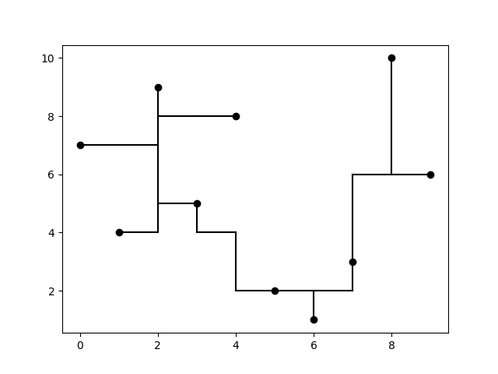
An example tree generated by our implementation. The bold points are the input terminals. We can see the optimisation of the tree when combining performed at x = 6.

Slide 16
Observations of the Evaluation
There is little change in the cost of the tree and running time when perturbing the inputs by a Gaussian noise.Hence the algorithm is overall stable with respect to perturbations.
This may be due to the fact that the algorithm is dividing the set of vertices into many districts of size at most 7 and hence adding gaussian noise does not affect the cost of the tree and runtime much.
Size of tree length varies the most between the perturbations for n=5600, with a value of 3726, and the variance is least for n=100, with a value of 9.
The time might not be exponential in cases because the bottleneck- fork() runs in O(3^n), but we are restricting n for district to be <=7, and so, 3^n might not become too big. So, although time for each district is constant, for a large number of points, number of districts ~ number of points, and so, total time complexity is proportional to n.

